Slide 1
Topics
Inheritance Basics - II

Slide 2
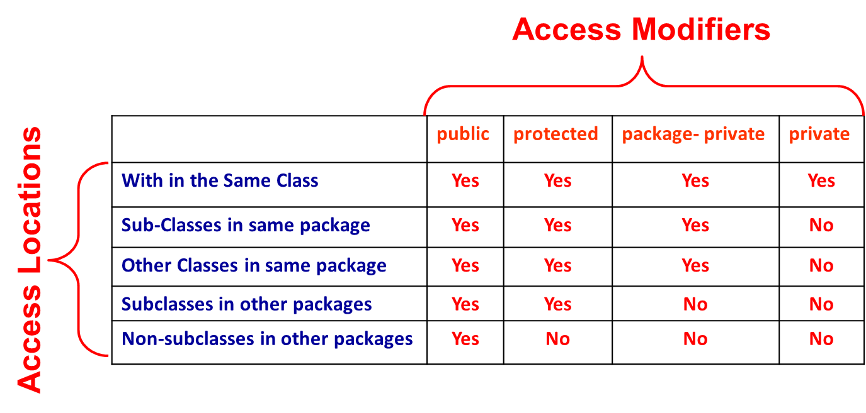
Inheritance Basics
Suppose A is super class of B. Then class B can inherit all the features (Methods and Instance Fields) of class A except the private members.
Super and Sub Classes May Either Belong to Same or Different Packages

Slide 3
Inheritance Basics ….
Whenever an instance of sub-class type is created, a super-class constructor is called first.
If a super-class constructor does not have any constructor of its own OR has an un-parametrized constructor then it is automatically called by JRE by using call super()
If a super-class has a parameterized constructor then it is the responsibility of the sub-class constructor to call the super class constructor by call
super(<parameters required by super class>)
Call to super class constructor must be the first statement in sub class constructor

Slide 4
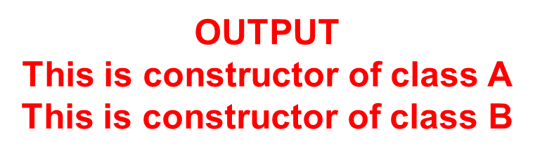
Extending Classes : Example 1
When super-class has an Un-parametrized Constructor
// File Name : Sample.java
class A
{
A()
{
System.out.println("This is constructor of class A");
}
} // End of class A
class B extends A
{
B()
{
super();
System.out.println("This is constructor of class B");
}
} // End of class B
class Test
{
public static void main(String[] args)
{
B b1 = new B();
}// End of Method
}// End of Class Test
Call to a Constructor Method of super-class

Slide 5
Extending Classes : Example 2
When a super-class has Either no or one Un-parametrized Constructor
// File Name : Sample.java
class A
{
A()
{
System.out.println("This is constructor of class A");
}
} // End of class A
class B extends A
{
B()
{
System.out.println("This is constructor of class B");
}
} // End of class B
class Test
{
public static void main(String[] args)
{
B b1 = new B();
}// End of Method
}// End of Class Test
No super() statement

Slide 6
Extending Classes : Example 3
When super-class has only a Parameterized Constructor
// File Name : Sample.java
class A
{
A(int x, int y)
{
System.out.println("This is constructor of class A");
}
} // End of class A
class B extends A
{
B()
{
System.out.println("This is constructor of class B");
}
} // End of class B
class Test
{
public static void main(String[] args)
{
B b1 = new B();
}// End of Method
}// End of Class Test
Results in Compile-Time Error.
A sub-class constructor does not call super-class constructor

Slide 7
Extending Classes : Example 3
When super-class has only a Parametrized Constructor
// File Name : Sample.java
class A
{
A(int x, int y)
{
System.out.println("This is constructor of class A");
}
} // End of class A
class B extends A
{
B(int a, int b)
{
super(a,b);
System.out.println("This is constructor of class B");
}
} // End of class B
class Test
{
public static void main(String[] args)
{
B b1 = new B();
}// End of Method
}// End of Class Test
A sub-class constructor must call a parameterized constructor of super-class
Note : super() statement must be the first statement in a sub-class constructor

Slide 8
Extending Classes : Example 4
‘final’ classes cannot have sub-classes
// File Name : Sample.java
final class A
{
A(int x, int y)
{
System.out.println("This is constructor of class A");
}
} // End of class A
class B extends A
{
B(int a, int b)
{
super(a,b);
System.out.println("This is constructor of class B");
}
} // End of class B
The Code Will Result in Compile-Time Error.

Slide 9
Role of super Keyword
‘super’ Java keyword primarily used for two purposes
To Call constructor method of super-class from a sub-class constructor
Syntax:
(i) super() ; // if super-class has only one un-parameterized constructor
(ii) super(<parameters>); // if super-class has only one parameterized constructor
To call a method of super-class in a sub-class method or to access an instance field of super-class in sub-class especially when their names are similar
Syntax:
(i) super.<super-class-method()> ;
(ii) super.<super-class-instance-field>;

Slide 10
Role of super : Example 1
// File Name : XYZ.java
class A
{
private int a; // instance-field
// Constructor Method
A( int a)
{
this.a =a;
System.out.println("This is constructor of class A");
} // End of Constructor
// print Method
void print()
{
System.out.println("a="+a);
} // End of Method
// Display Method
void display()
{
System.out.println("hello This is Display in A");
} // End of Method
} // End of class A
class B extends A
{
private int b; // instance field
private double c; // instance field
B(int a,int b,double c)
{
super(a);
this.b=b;
this.c=c;
System.out.println("This is constructor of class B");
}// End of Constructor Method
// show Method
void show()
{
print();
System.out.println("b = “ + b);
System.out.println("c = “ + c);
}// End of Method
} // End of class B
Call to print() method of super-class
Can be Written as super.print()
Call to super-class
Constructor

Slide 11
Role of super : Example 2
// File Name : XYZ.java
class A
{
protected int a = 20; // instance-field
} // End of class A
class B extends A
{
private int a = 30;
void show()
{
int a = 50;
System.out.println(“ a= “ + a);s
System.out.prinltn(“ a= “+ this.a);
System.out.println(“ a = “+ super.a);
}// End of Method
}// End of class B

Slide 12
Role of super : Example 3
// File Name : XYZ.java
class A
{
private int a; // instance-field
// Constructor Method
A( int a)
{
this.a =a;
System.out.println("This is constructor of class A");
} // End of Constructor
// print Method
void print()
{
System.out.println("a="+a);
}
// Display Method
void show()
{
System.out.println(“Hello This is Display in A");
}
} // End of class A
class B extends A
{
private int b; // instance field
private double c; // instance field
// Constructor Method
B(int a, int b, double c)
{
super(a);
this.b=b;
this.c=c;
System.out.println("This is constructor of class B");
}// End of Constructor Method
// show Method
void show()
{
super.show();
System.out.println("b = “ + b);
System.out.println("c = “ + c);
}// End of Method
} // End of class B
Call to show() method of super-class
Call to super class Constructor

Slide 13
Thank You

